Slide 1
Supervisors: Dr. Naoufel Werghi - Dr. Muzammal Nasser - Dr. Maregu Asefa
Examiners: Dr. Panos Liatsis - Dr. Mohammad Alsharid
Team Members: Alanood Alharmoodi - 100053854
Rodha Alhosani - 100058376
Shaikha Alhammadi - 100058710
Yasmine Benkhelifa - 100059531
Computer Science – SDP 1 MIDTERM PRESENTATION – FALL 2024
Classroom Occupancy Monitoring and Behavior Analysis System

Slide 2
Content
_____
Introduction
Problem Statement and Objectives
Motivation
Requirements
Methodology
Technologies Used
Data Protocol
Model Training Process
Evaluation Metrics
Model Output
Challenges
Next Steps
Conclusion

Slide 3
Introduction
______________

Slide 4
Problem Statement and Objective
_____
Problem Statement
Traditional monitoring methods are error-prone and time-consuming.
Need for real-time, automated solutions in classrooms.
Objective
Develop an AI-driven system to monitor classroom to detect illegal objects and alert when unauthorized access to restricted area.

Slide 5
Motivation
_____
Create a safe, efficient classroom environment.
Detect illegal objects (cups, mugs, bottles).
Notify unauthorized access in restricted areas.
Reduce reliance on manual labor.

Slide 6
Requirements
______________

Slide 7
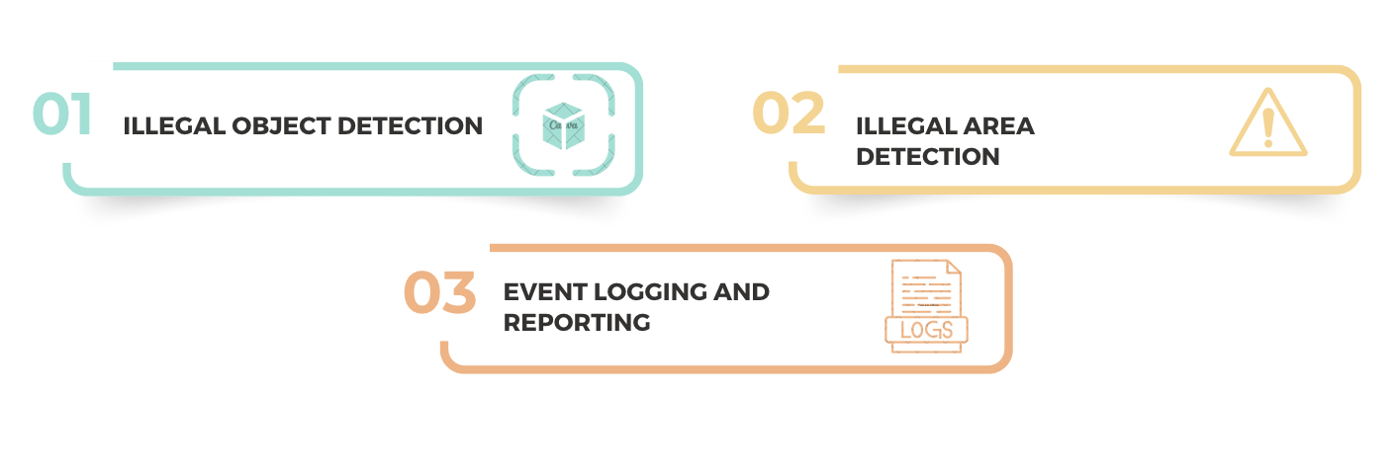
Functional Requirements

Slide 8
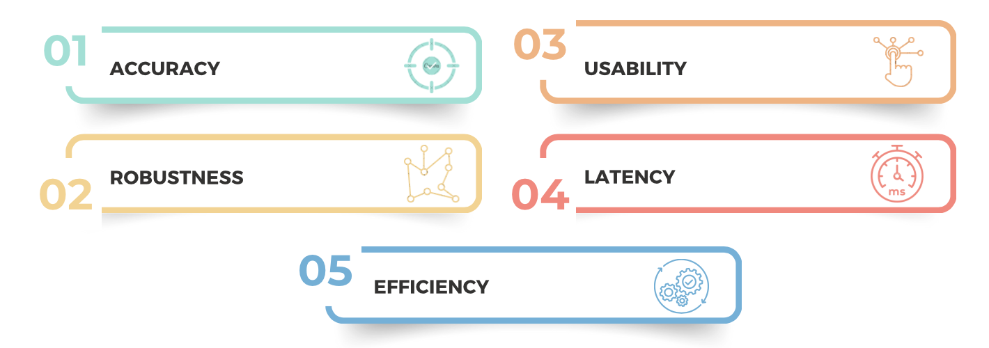
Non-Functional Requirements

Slide 9
Methodology
______________

Slide 10


Technologies Used

Slide 11


Technologies Used

Slide 12

Technologies Used

Slide 13
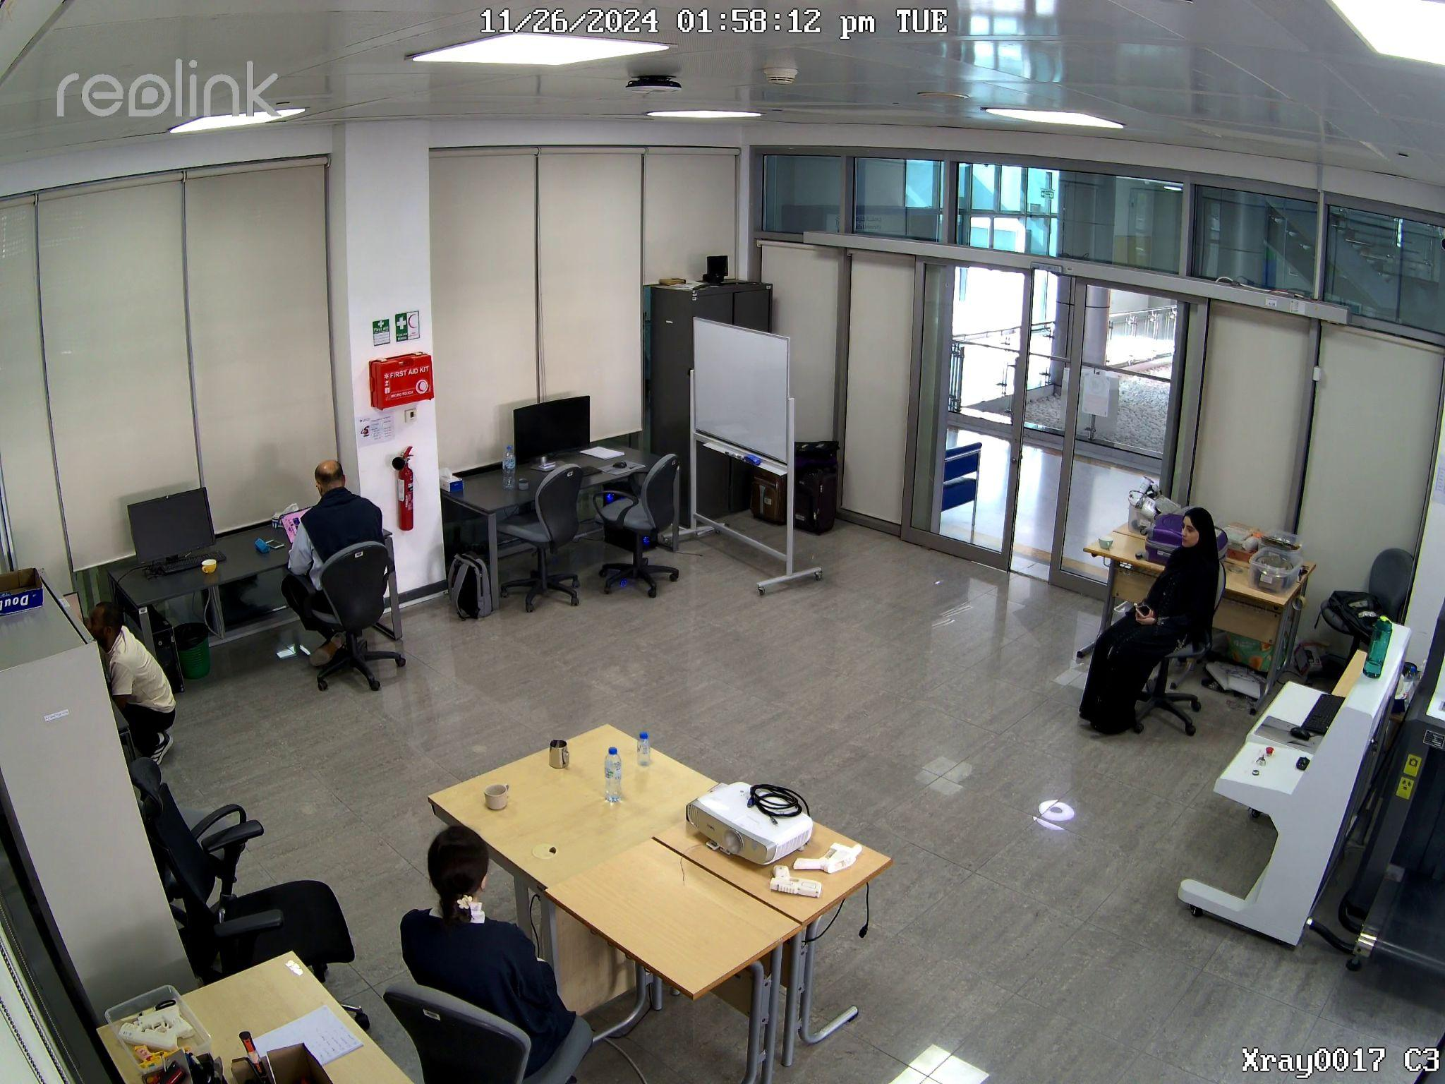
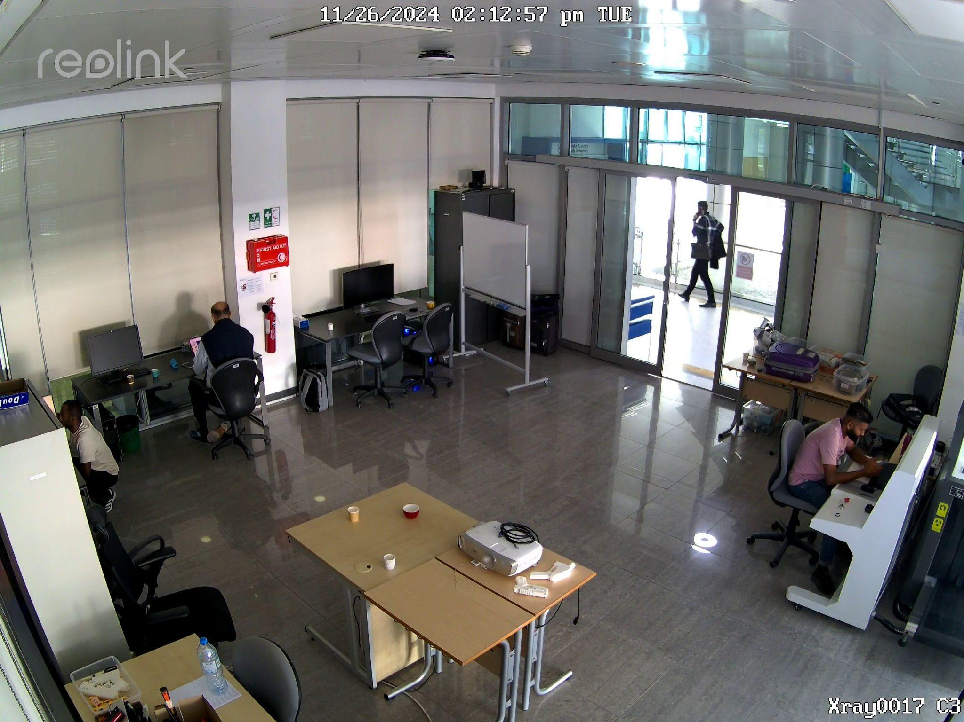
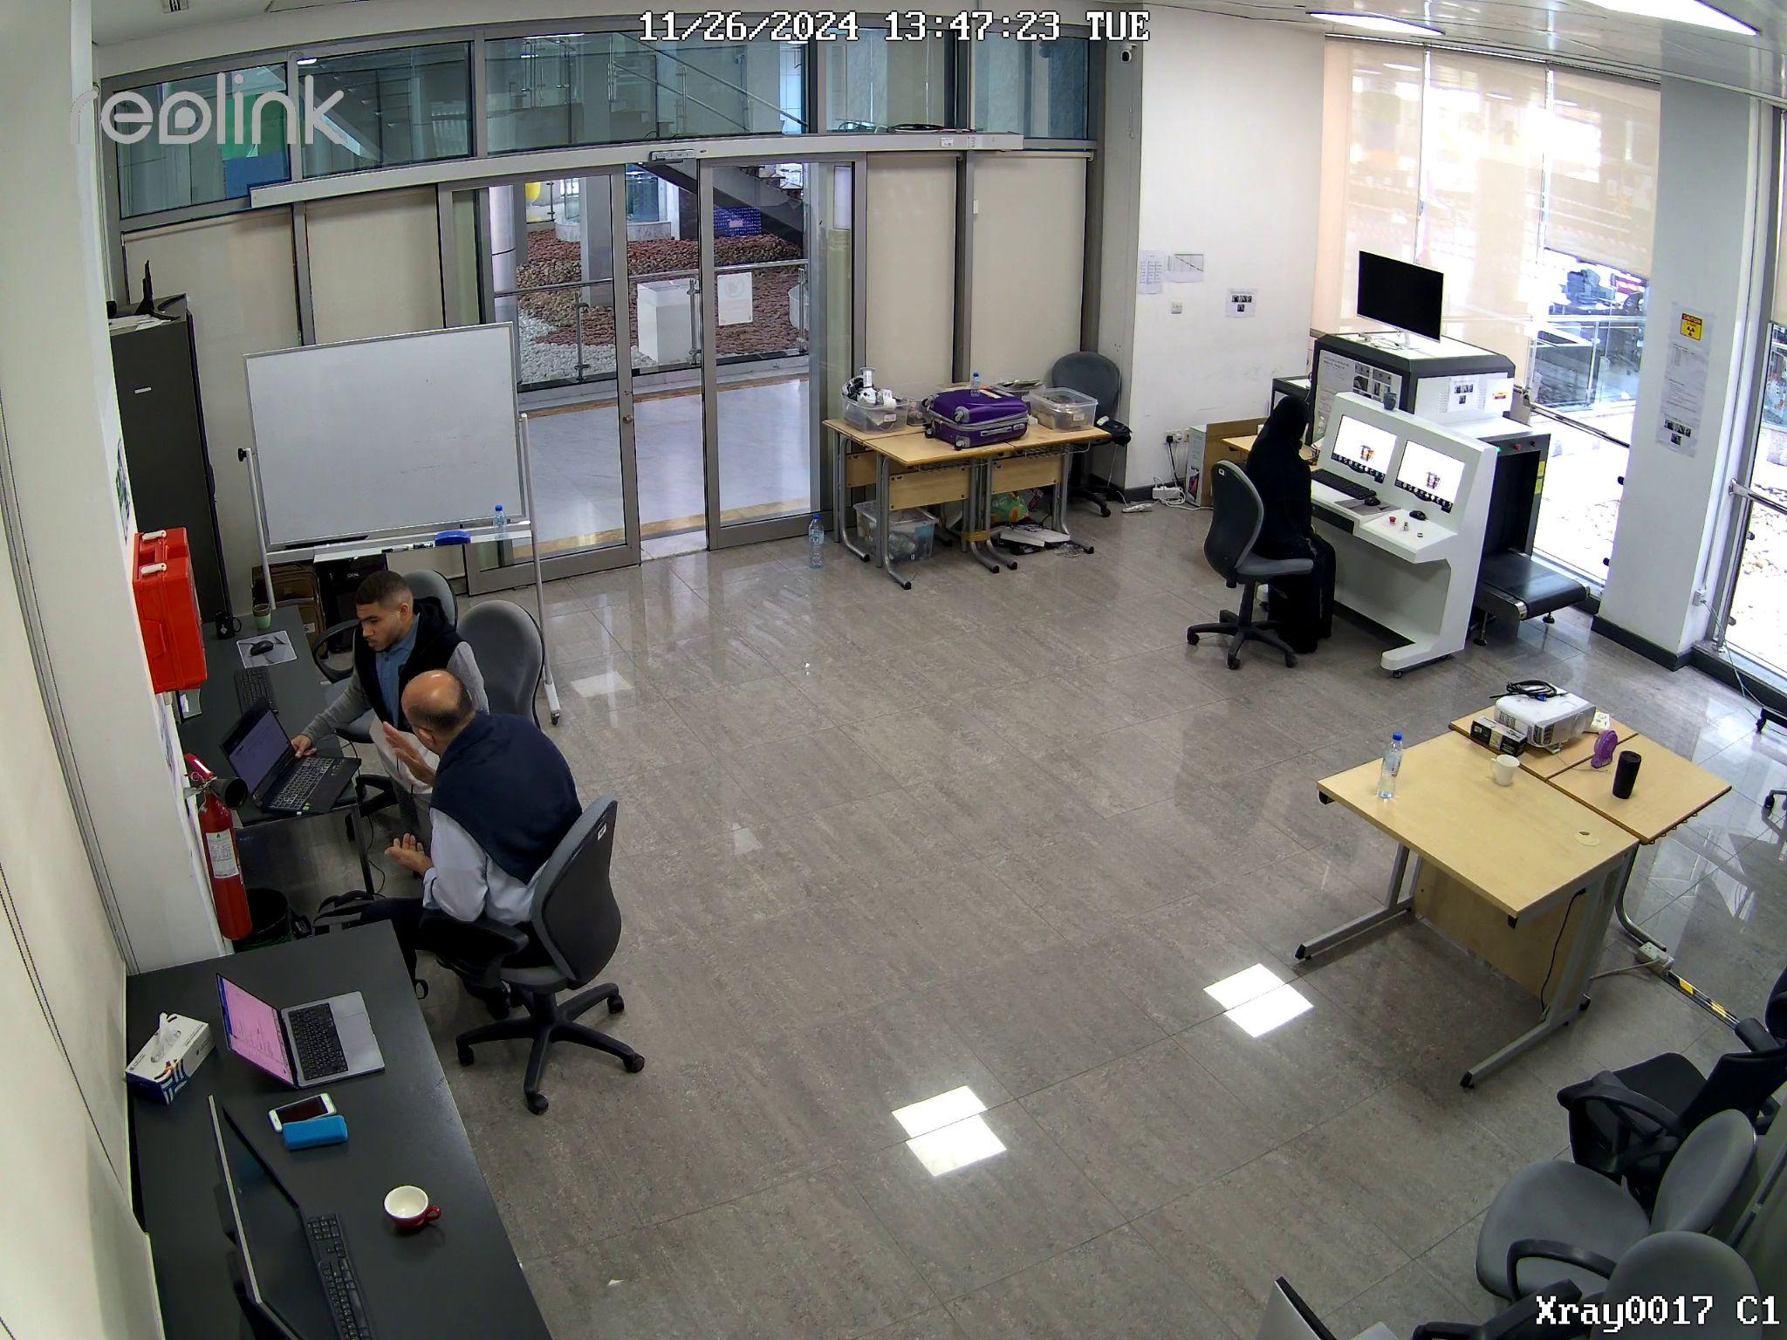
Data Collection
Total of videos Collected: 56 Videos

Slide 14

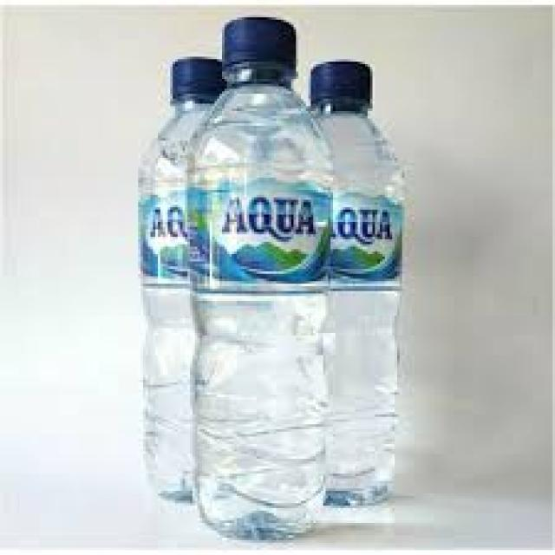

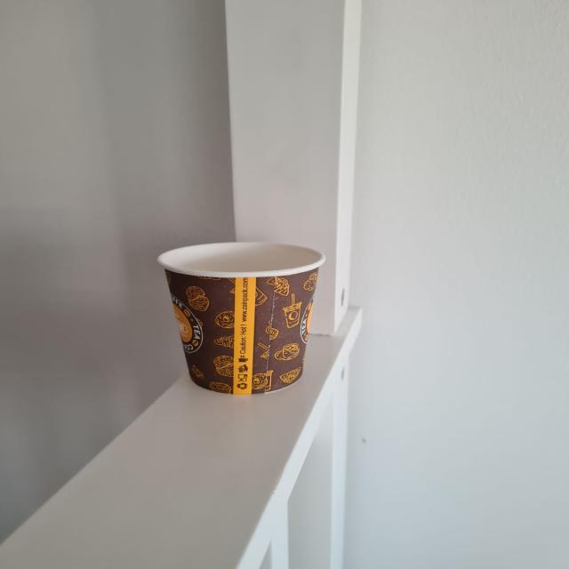
Data Collection
Total of data Collected: 1204

Slide 15
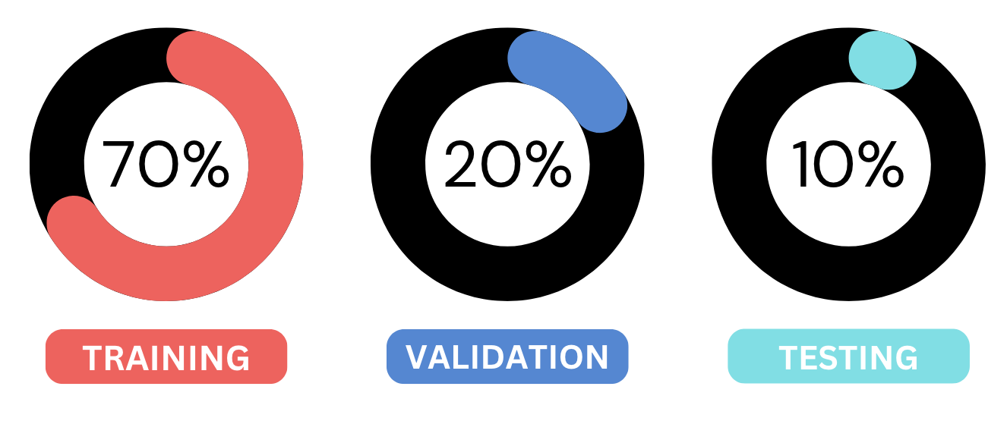
Dataset Split

Slide 16
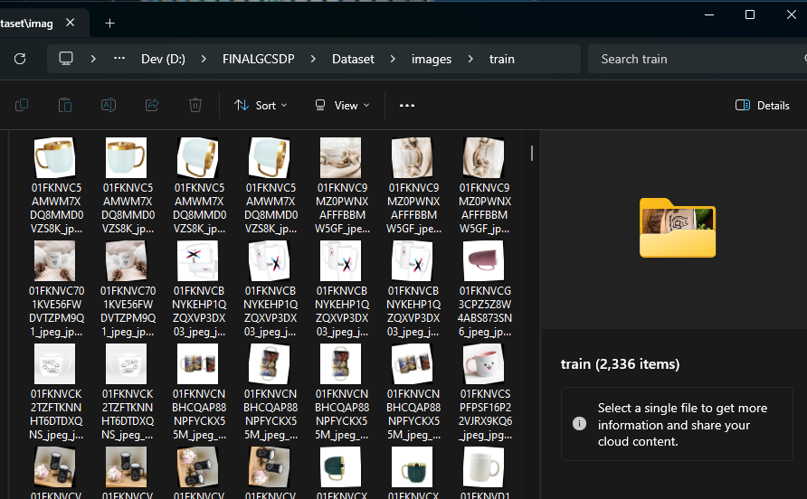
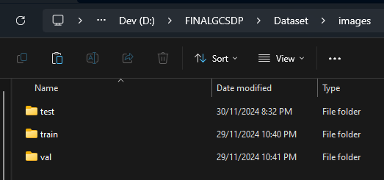
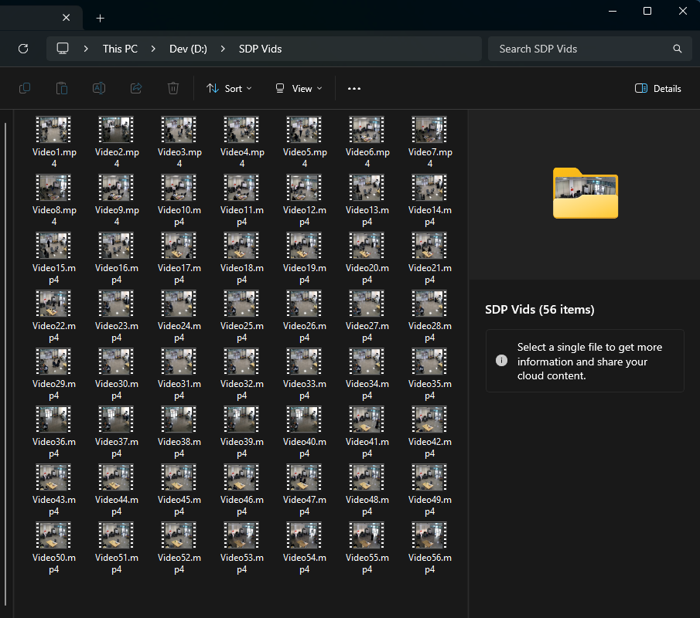
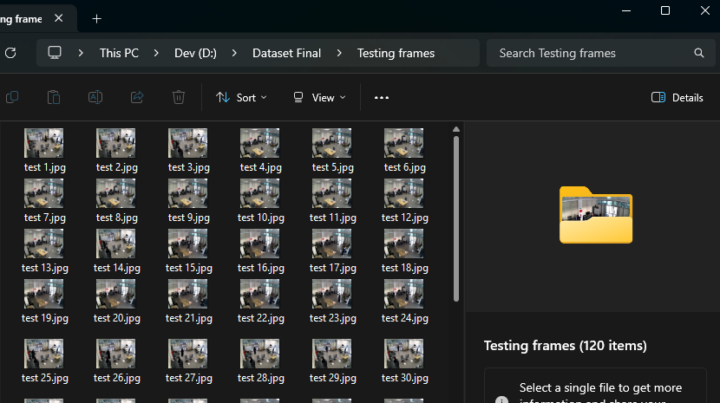
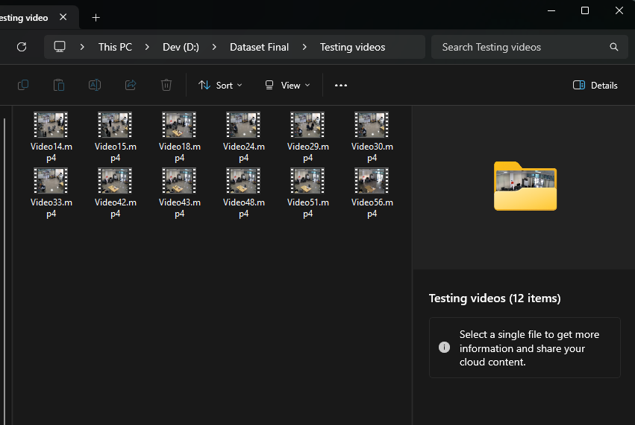
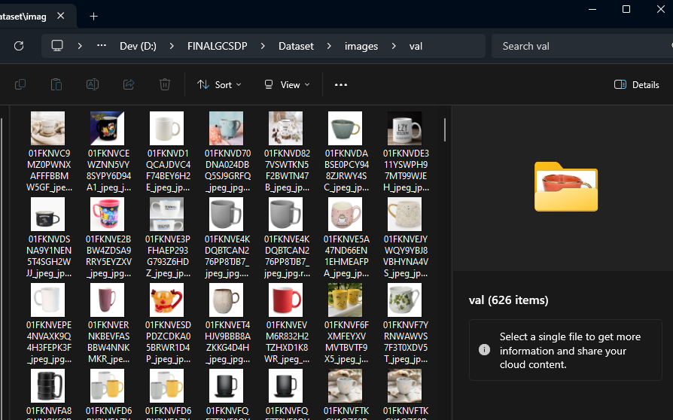
Dataset Split

Slide 17
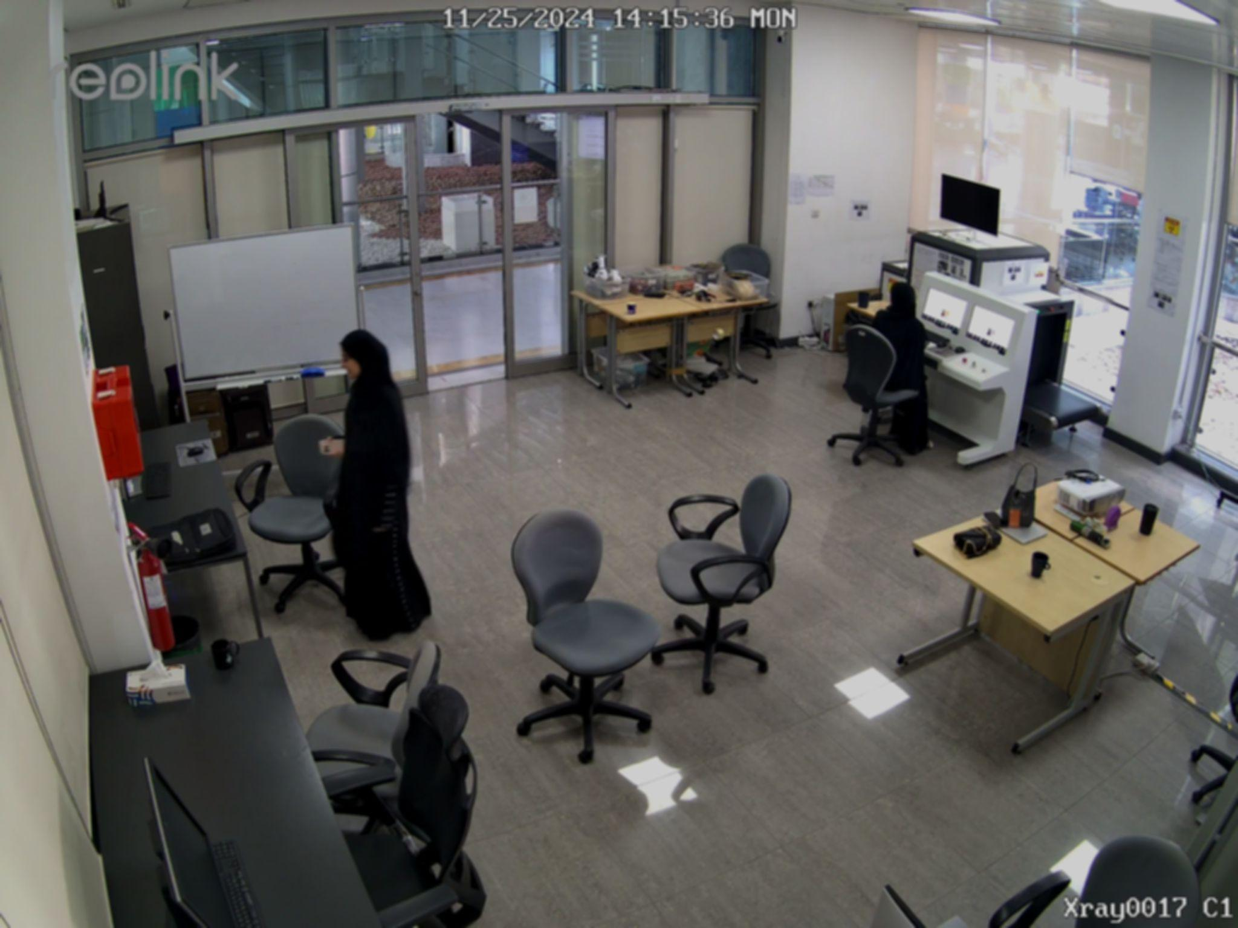
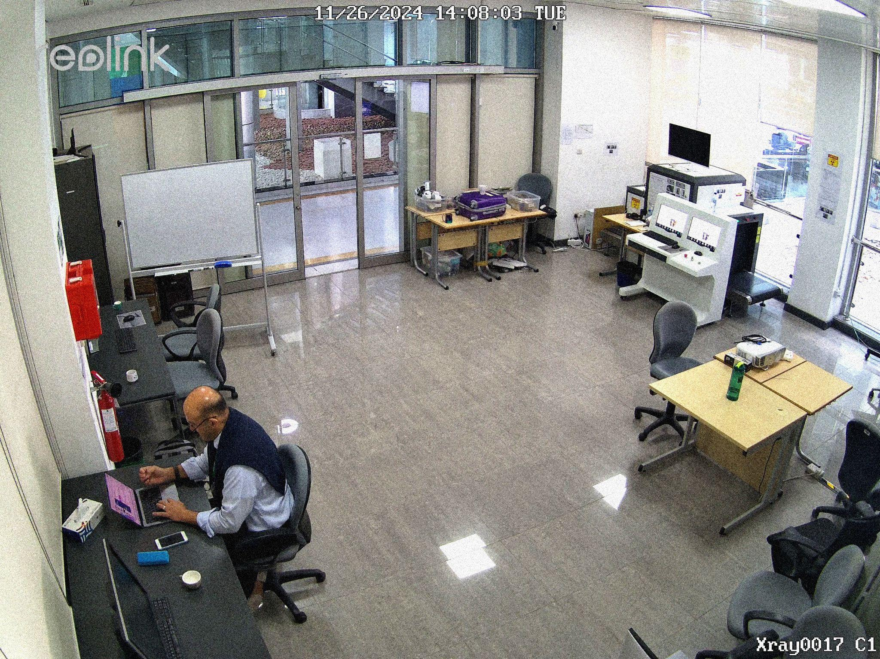
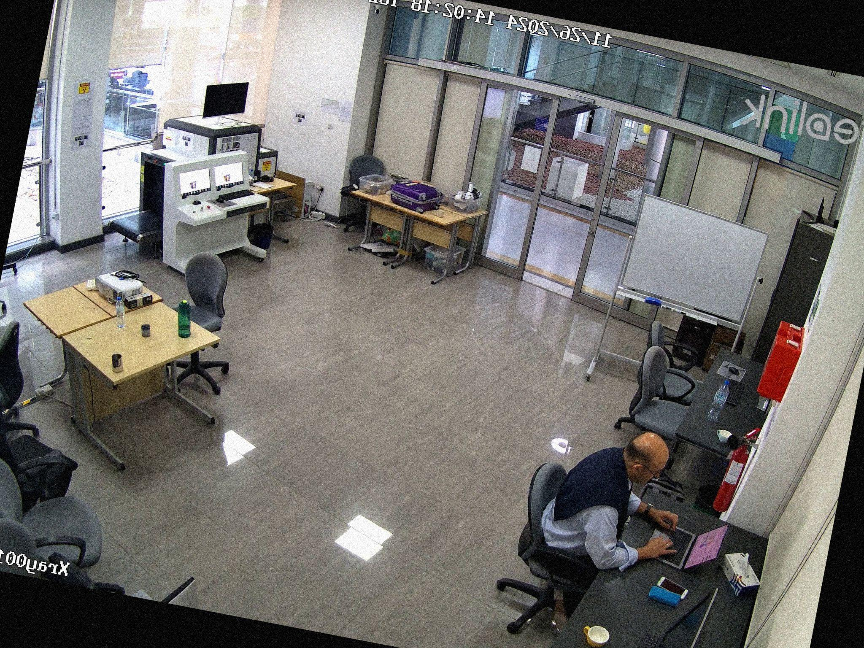
Data Augmentation
Grainy
Low Brightness & Blurred
Rotated & Flipped

Slide 18

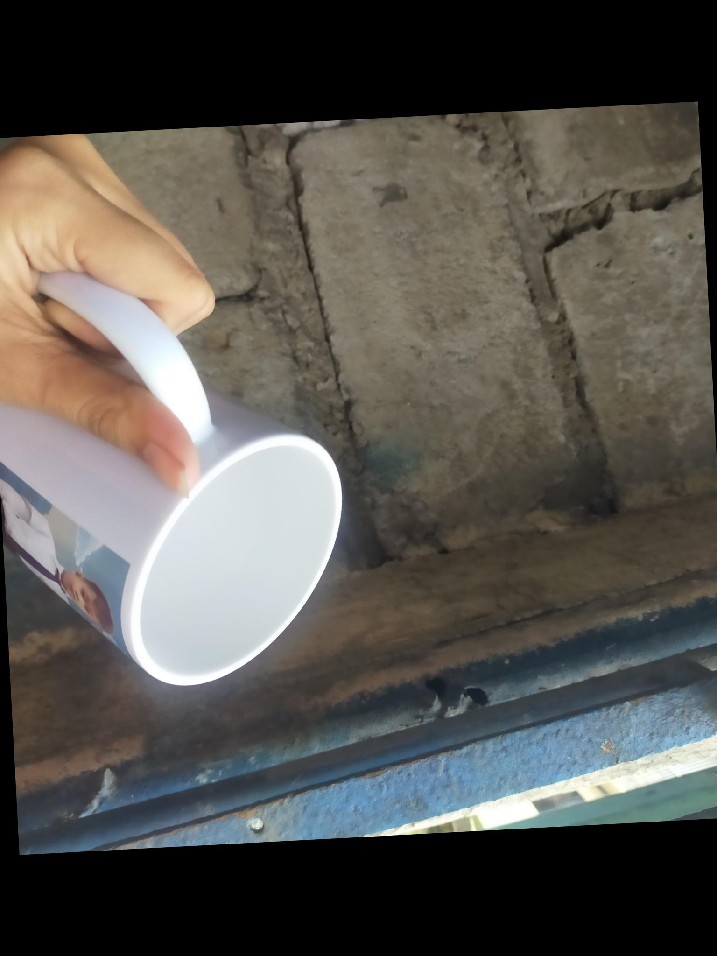
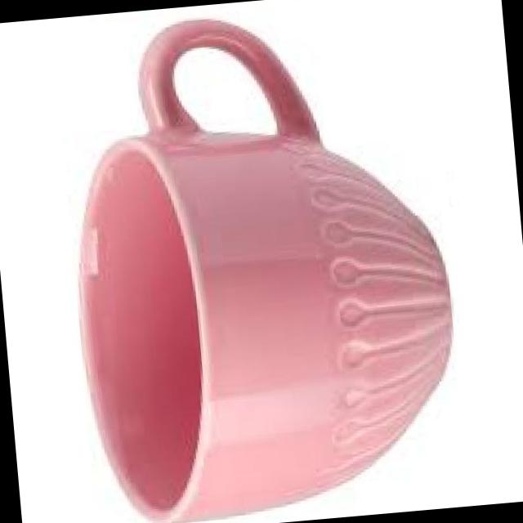
Data Augmentation
Blurred & Flipped
Rotated
Rotated & Flipped

Slide 19
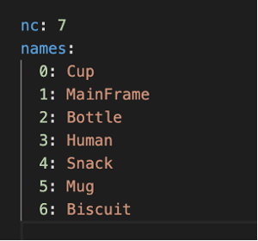
Model Configuration with data.yaml
The classes listed in data.yaml guide the annotation process

Slide 20
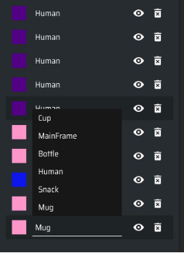
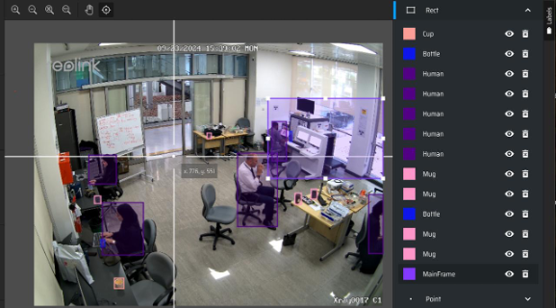
Data Annotation Using MakeSense

Slide 21
Model Training Process
______________

Slide 22



Model Selection

Slide 23
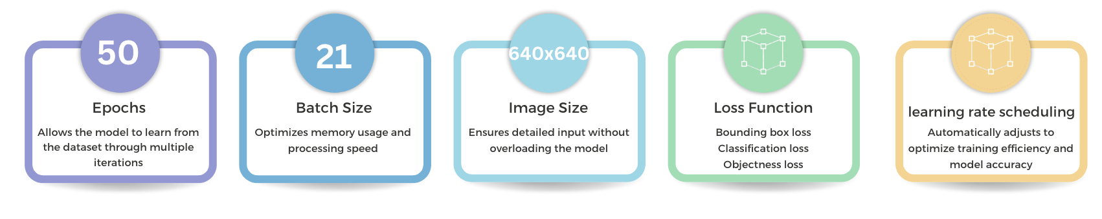
Training Parameters for Effective Model Learning

Slide 24
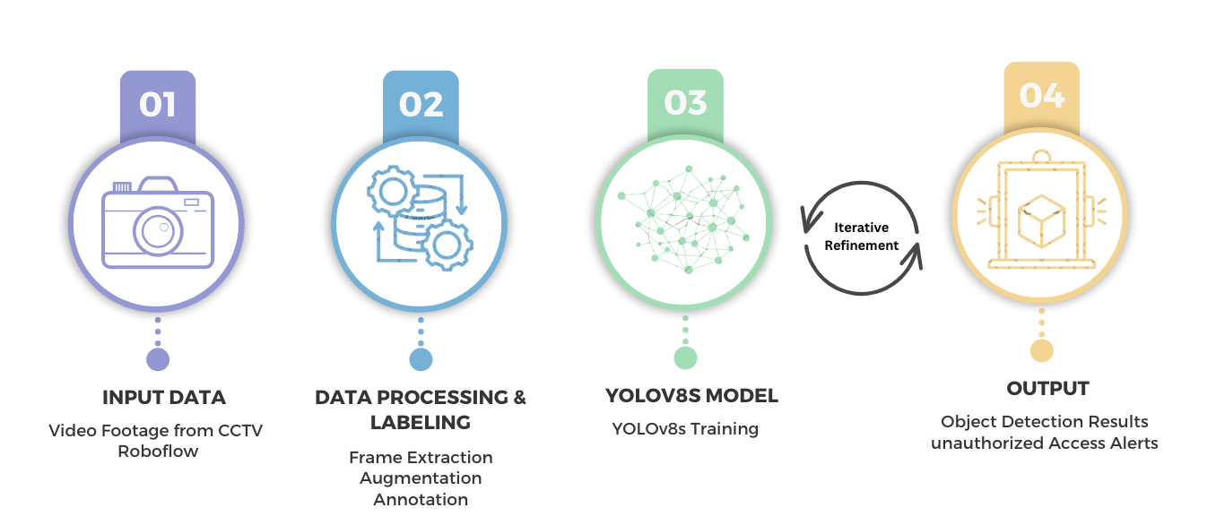
Training Workflow

Slide 25
Evaluation Metrics Used in Training

Slide 26
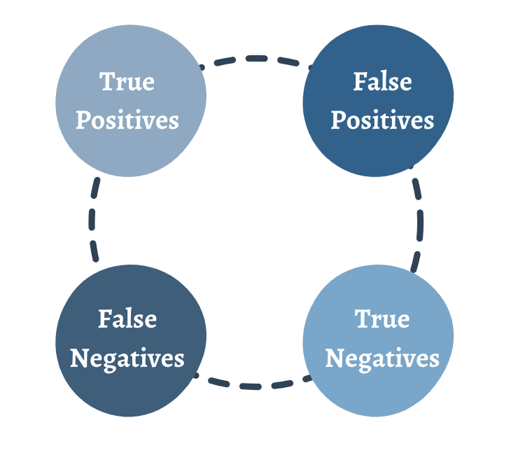
Confusion Matrix

Slide 27
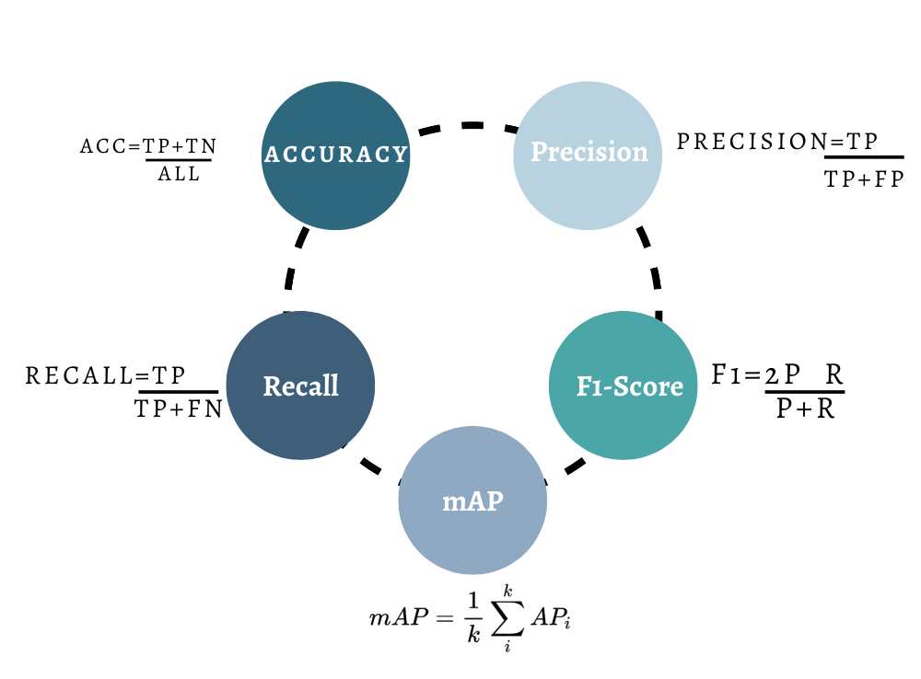
Evaluation Metrics

Slide 28
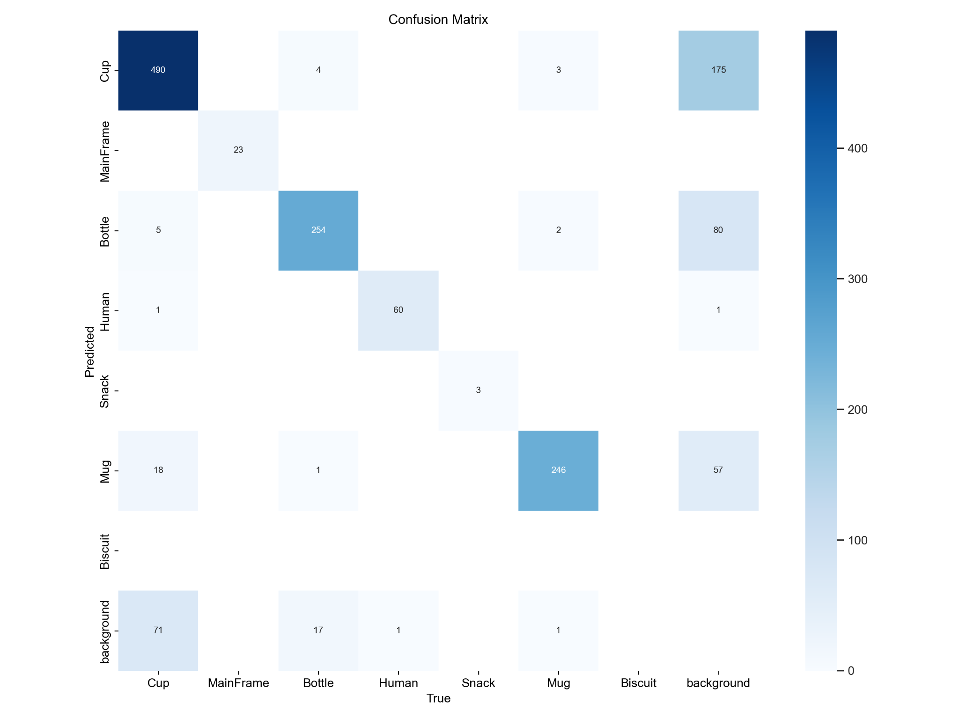
Confusion Matrix

Slide 29
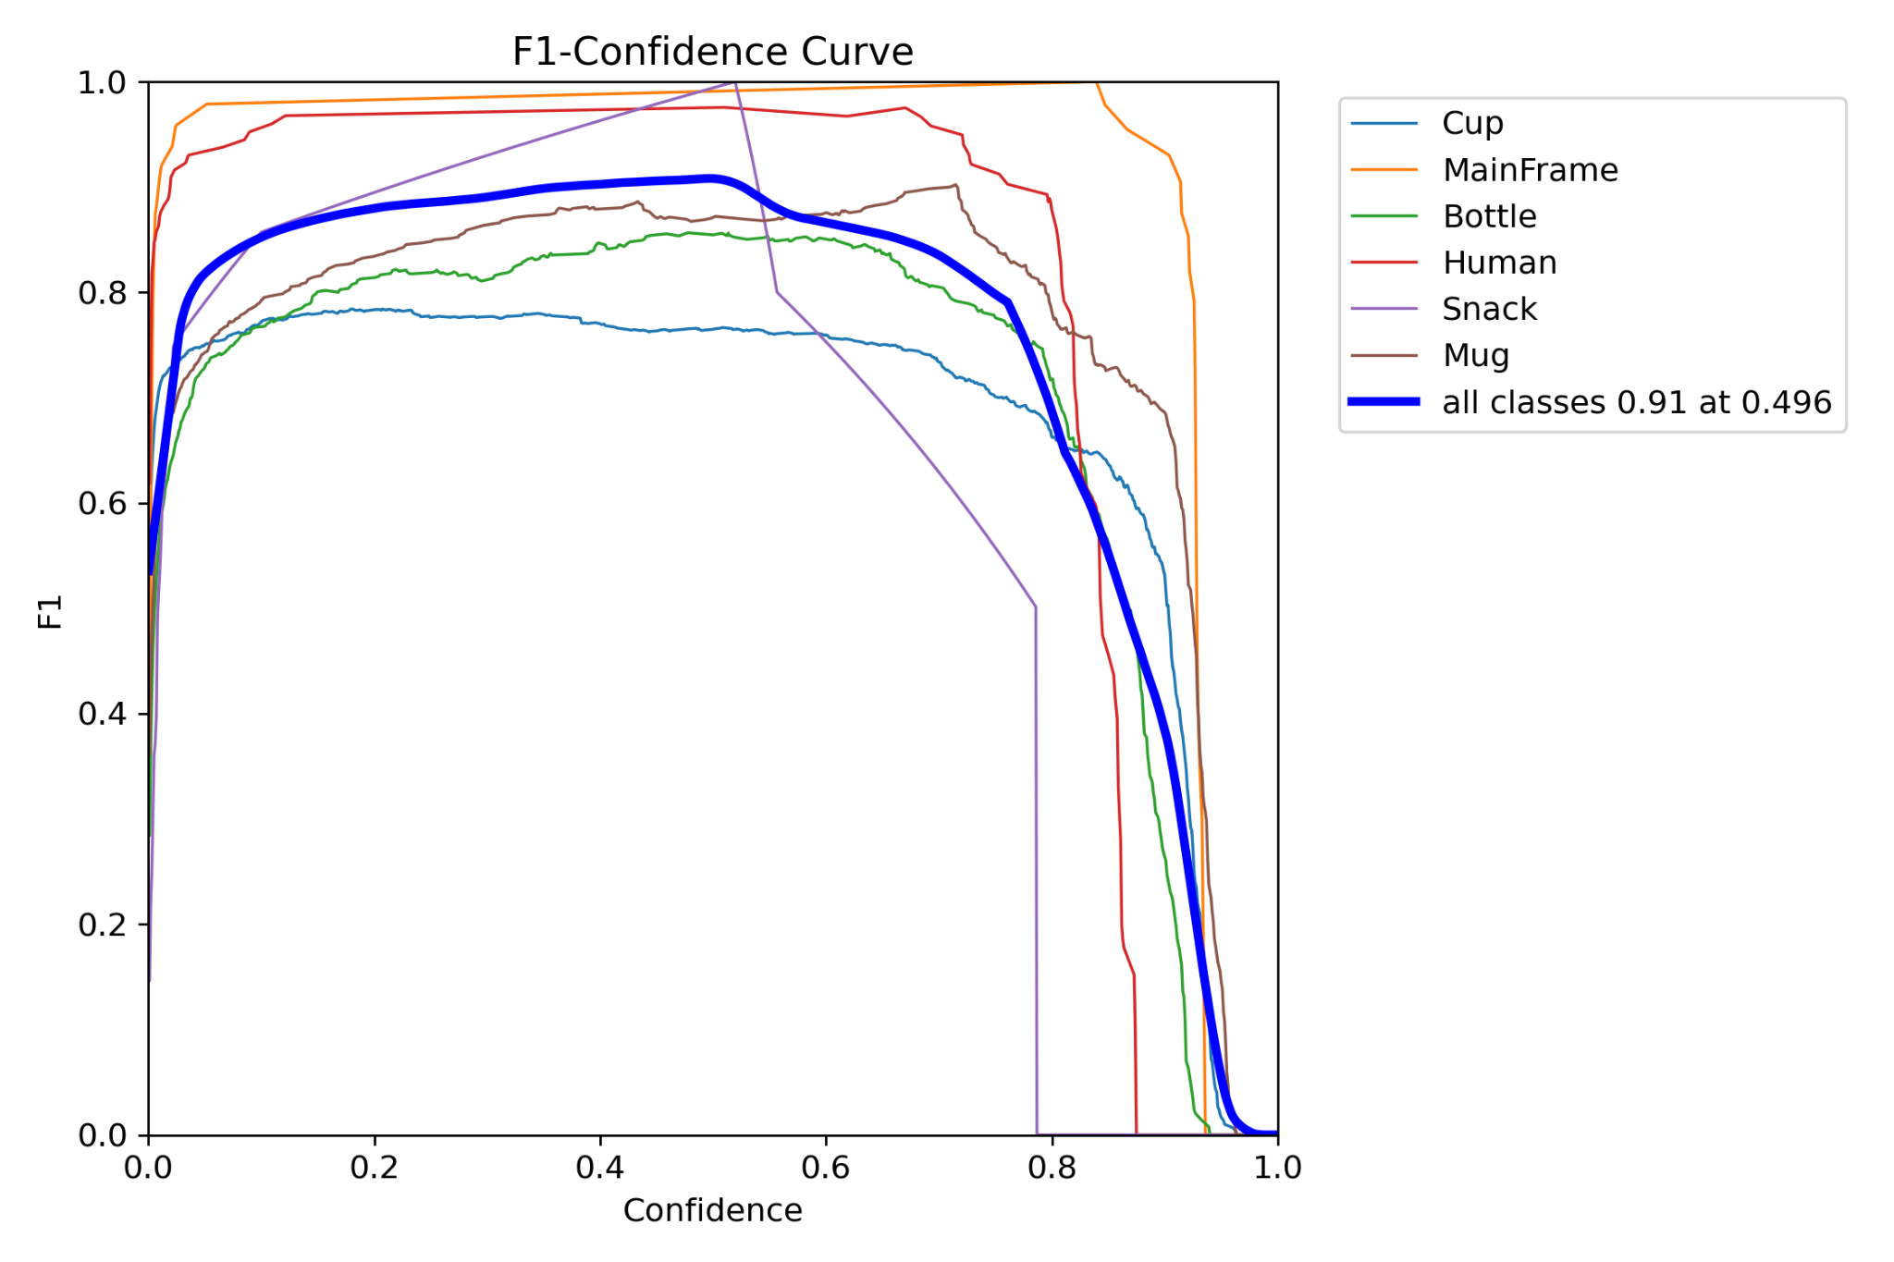
F1 Confidence Curve

Slide 30
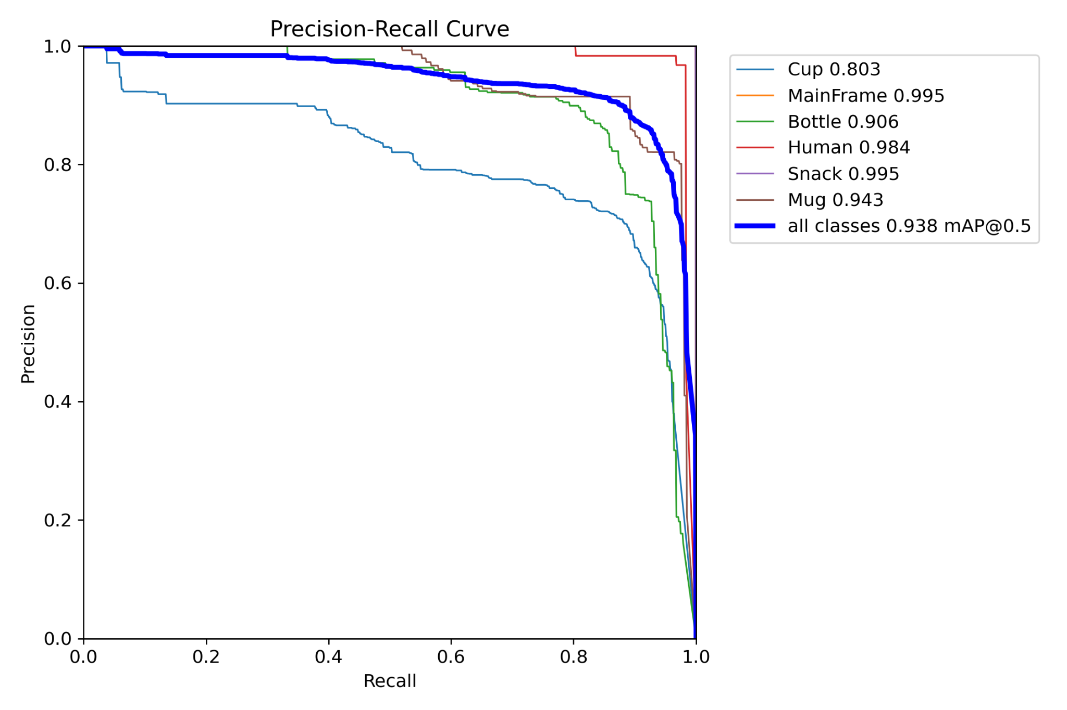
Precision - Recall Curve

Slide 31
Model Output
______________

Slide 32
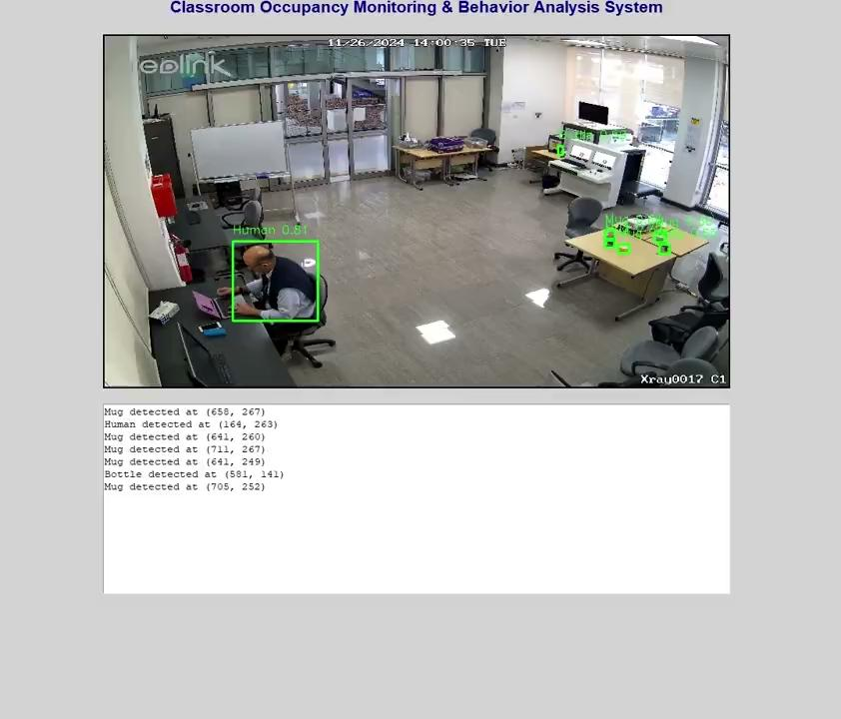
Results
Case 1: Object Detection with light

Slide 33
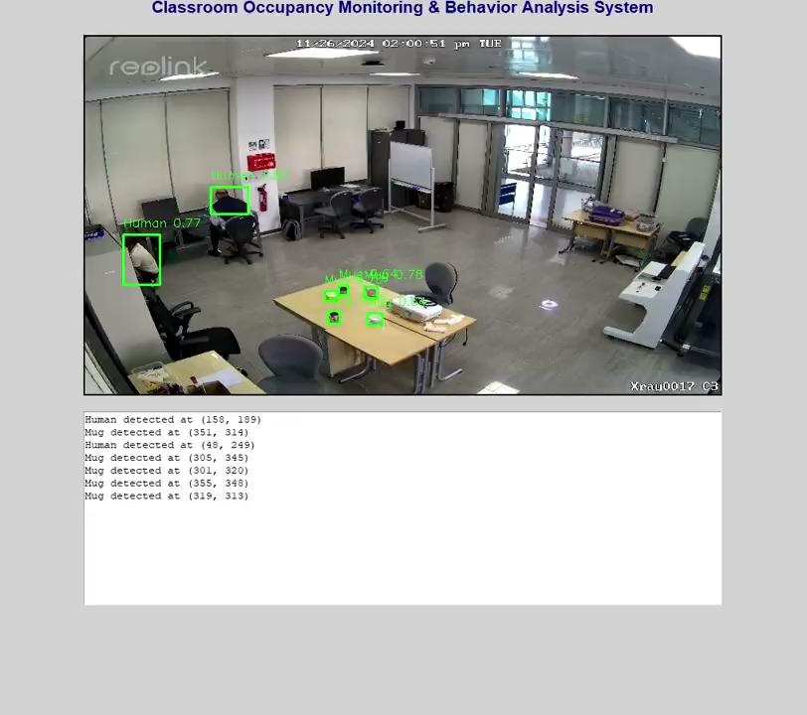
Case 2: Object Detection with different angle

Slide 34
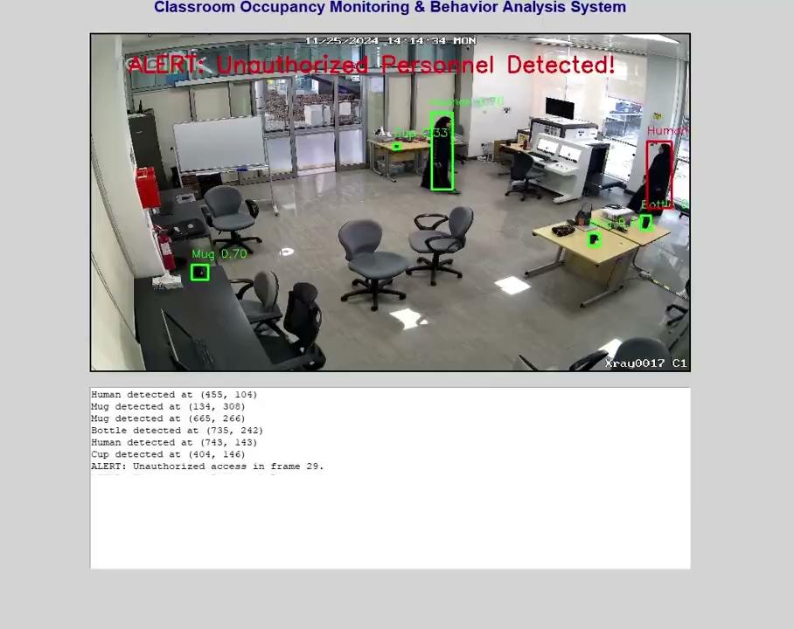
Case 3: Restricted area with light

Slide 35
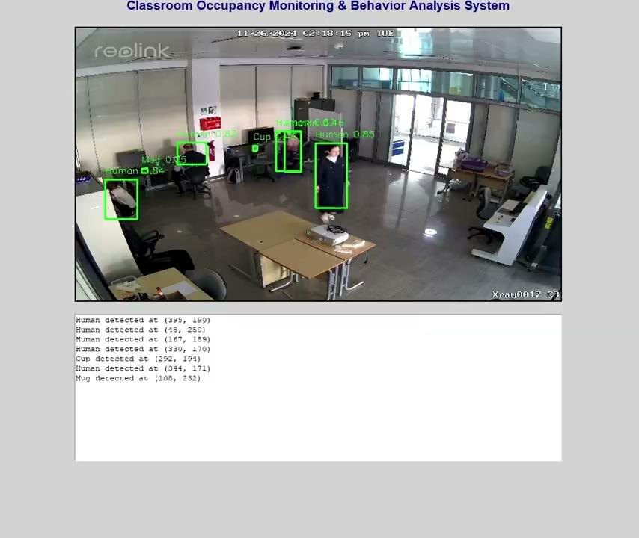
Case 4: Restricted area without light

Slide 36
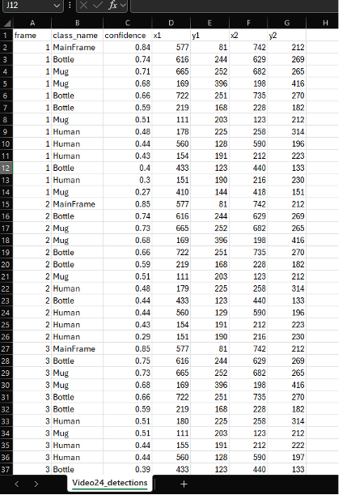
Data Logging: CSV Output for Detection Alerts

Slide 37
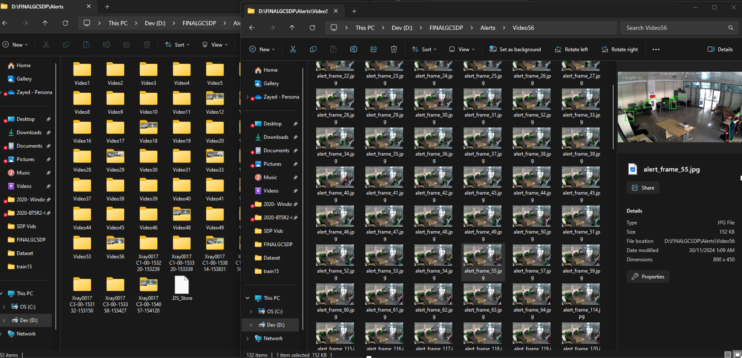
Automated Alert Folders for Unauthorized Access Incidents

Slide 38
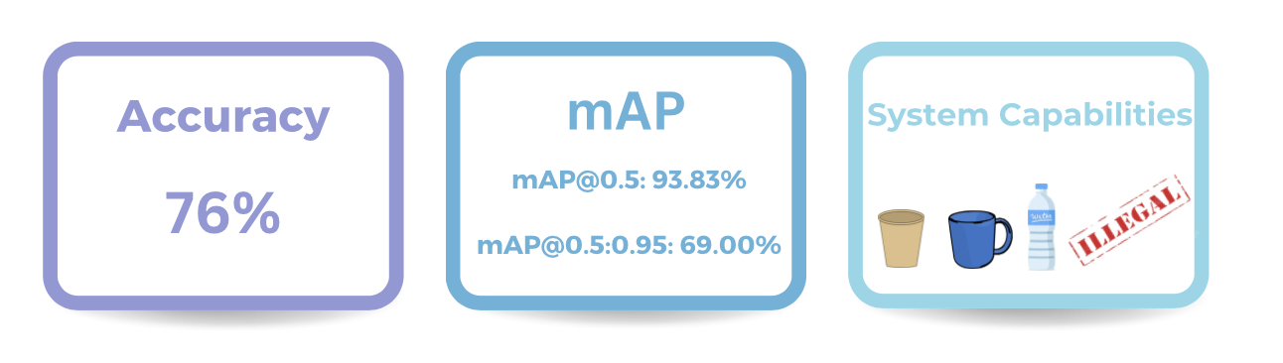
Performance of the Model

Slide 39
Challenges
______________

Slide 40
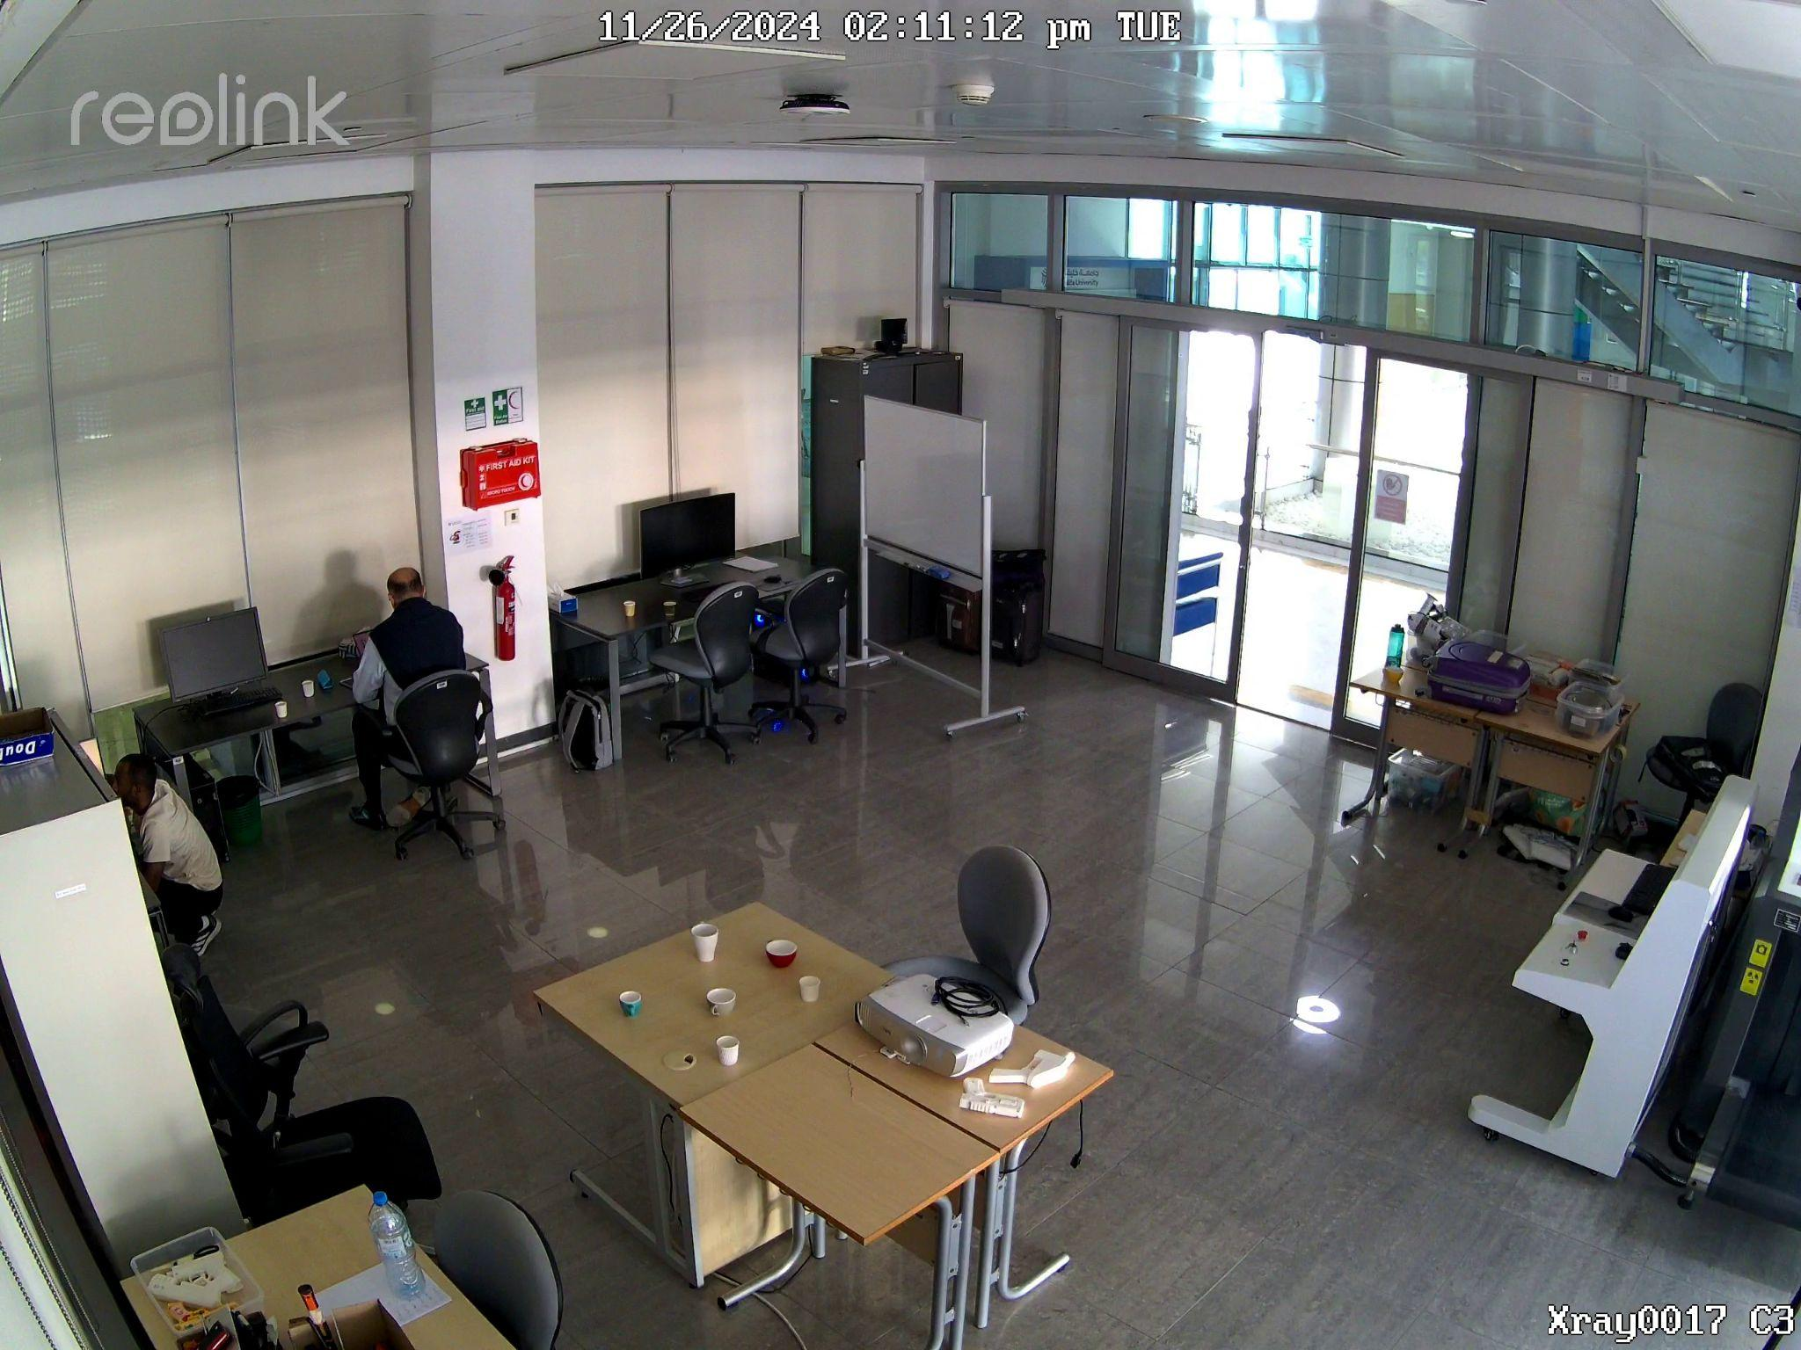
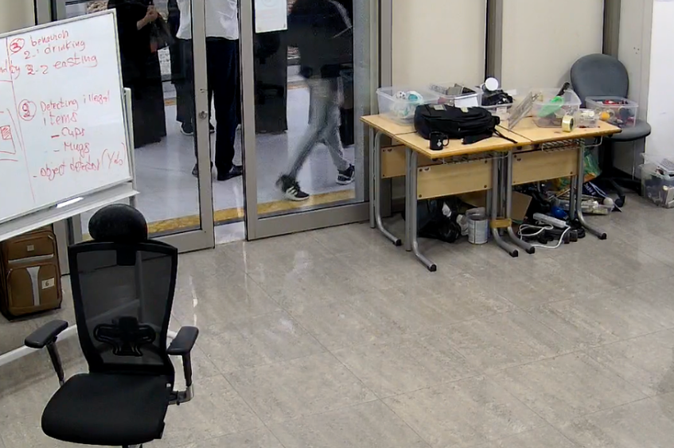
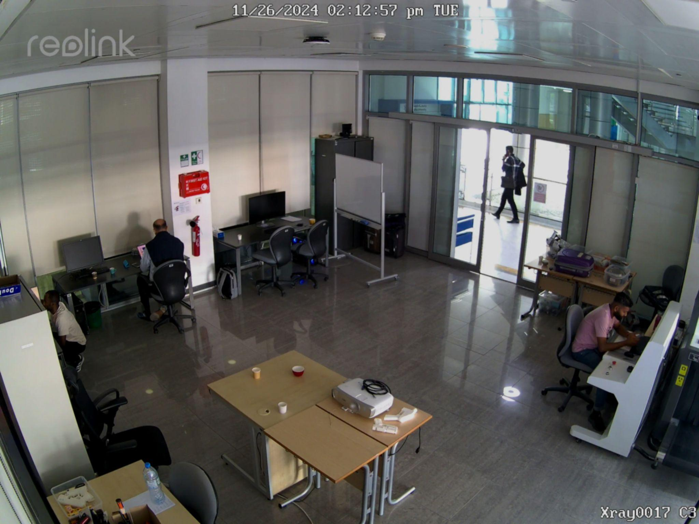
Challenges
Overlapping Objects
Black Mug Behind a Black Bag
Dim Lighting

Slide 41
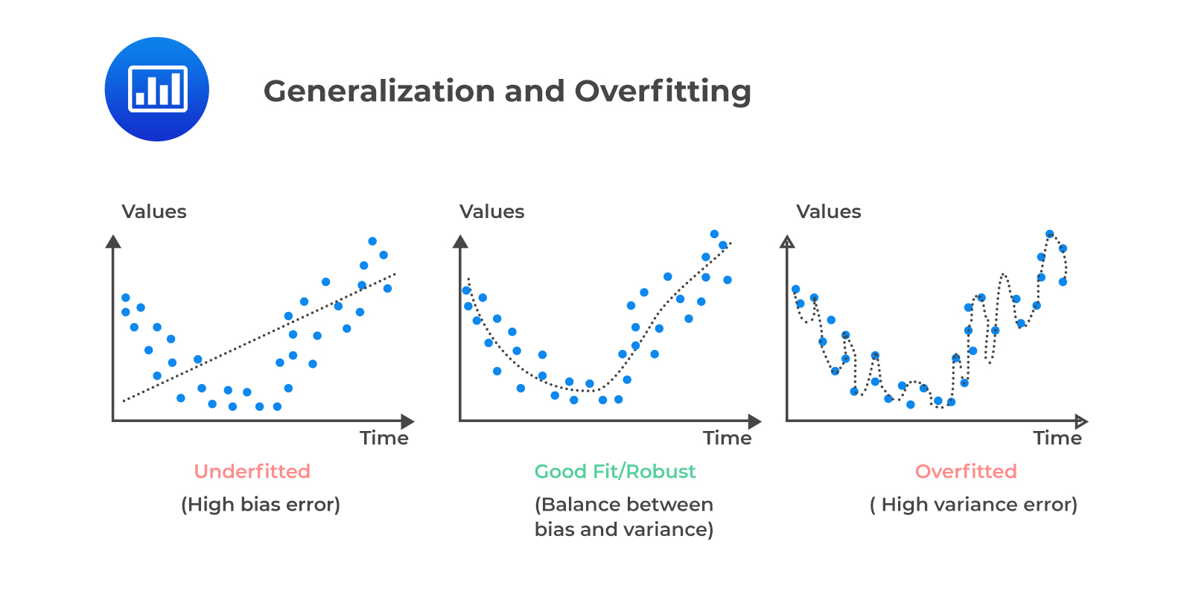
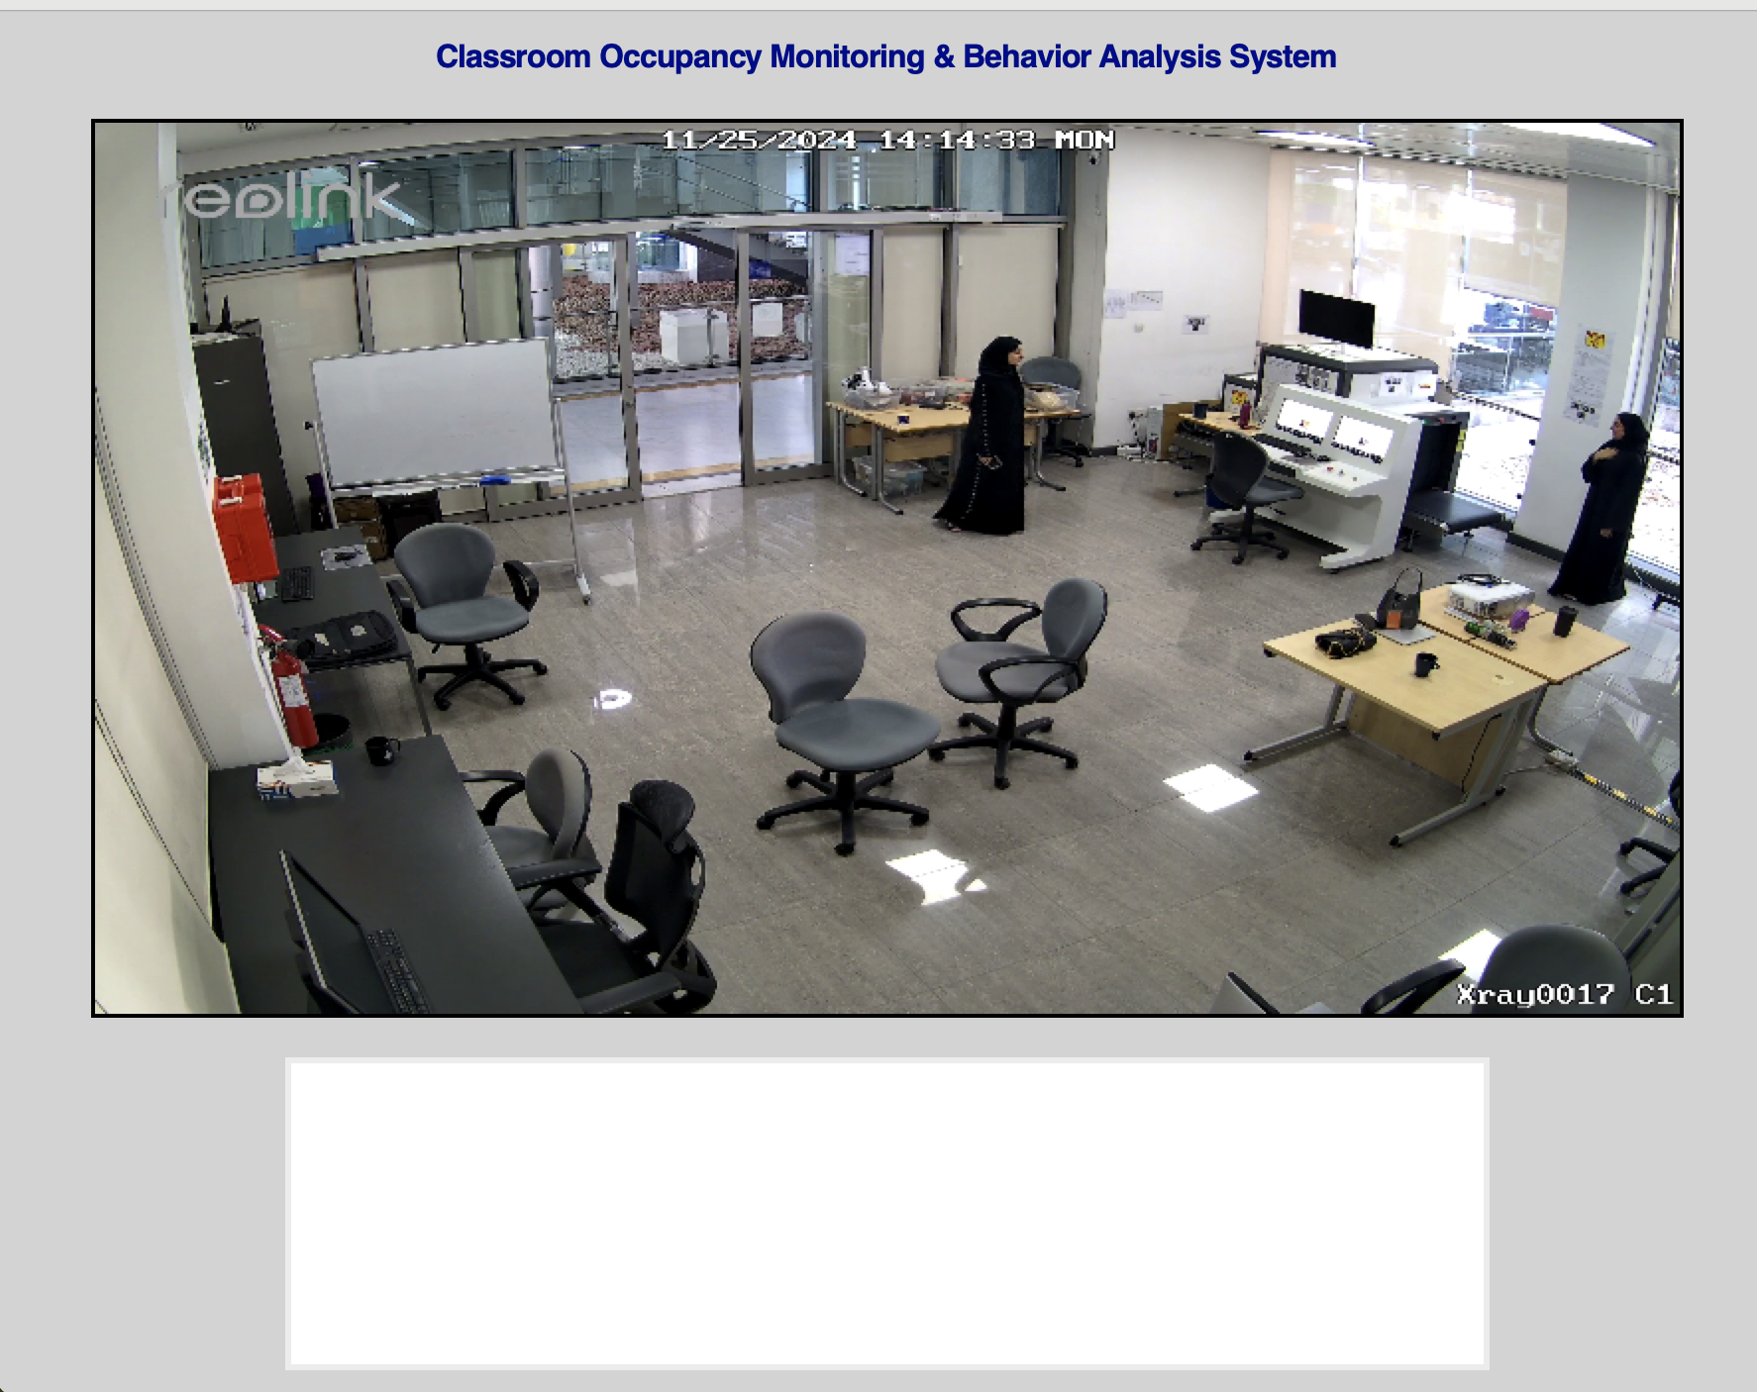
Failure Cases

Slide 42
Next Steps
______________

Slide 43
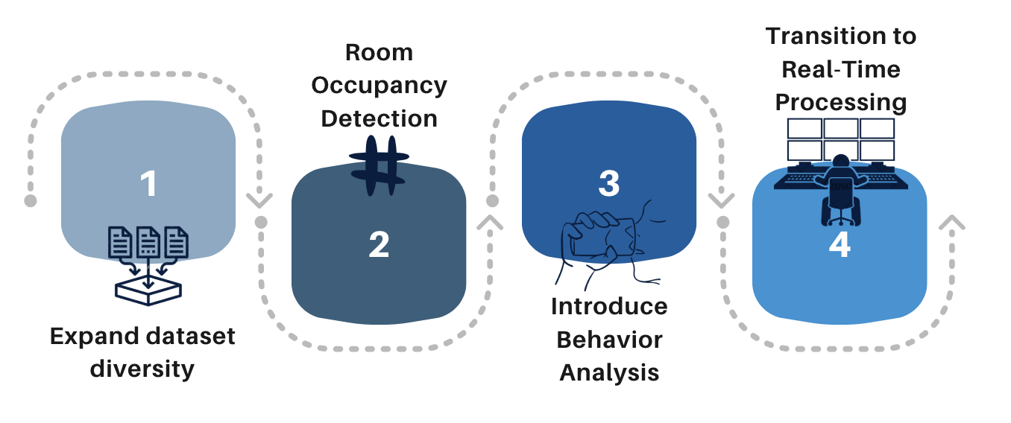

Slide 44
Conclusion
______________

